Slide 1


EXPLORATORY DATA ANALYSIS
ON VEHICLE INSURANCE DATASET
Turning raw insurance data into business insights
👨‍💻 SUBMITTED BY: SHRIA BHARDWAJ
👨‍💻 SUBMITTED TO: MRS. NEERAJ SHARMA
(SKILL CIRCLE)
📅 April 2025

Slide 2

PROJECT INTRODUCTION
Understand key patterns and customer behaviors from a large vehicle insurance dataset.
Why it matters:
1
HELPS INSURERS TARGET THE RIGHT CUSTOMERS
2
REDUCES POLICY CHURN
3
INFORMS BETTER MARKETING AND PRICING STRATEGIES

Slide 3
DATASET OVERVIEW
📁 Source: Vehicle_Insurance.csv
📊 Size: 381,109 records | 12 features
Key Columns:
Demographics: Gender, Age
Vehicle Info: Age, Damage
Financials: Premium, Policy Channel
Target: Response (Insurance Interest)

Slide 4
TECH STACK
Tools & Libraries Used
Python (Pandas, NumPy)
Seaborn & Matplotlib for visualization
Jupyter Notebook for analysis
Statistical techniques for outlier detection

Slide 5
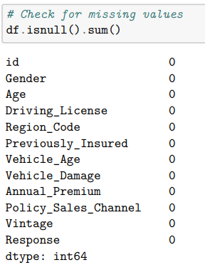
DATA CLEANING & PREPROCESSING
🧹 Data Quality Checks:
✅ No missing values
📉 Outlier treatment via IQR (Annual Premium, Driving License)
🔄 Filtered for high-quality, model-ready data

Slide 6
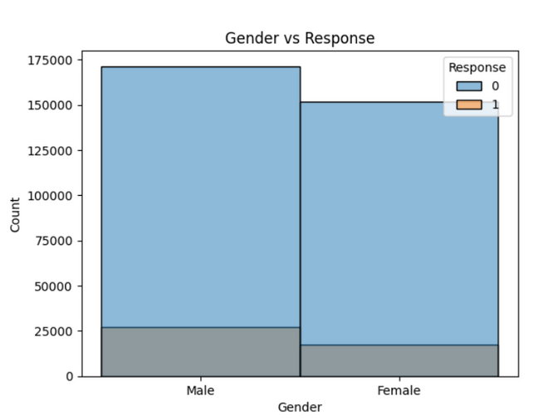
EXPLORATORY VISUALIZATIONS
📊 Techniques Used:
Histograms for distribution (Age, Gender, Premiums)
Countplots to compare Response rates
Boxplots to examine spread and outliers
🧠 Uncovered key behavioral and financial patterns

Slide 7
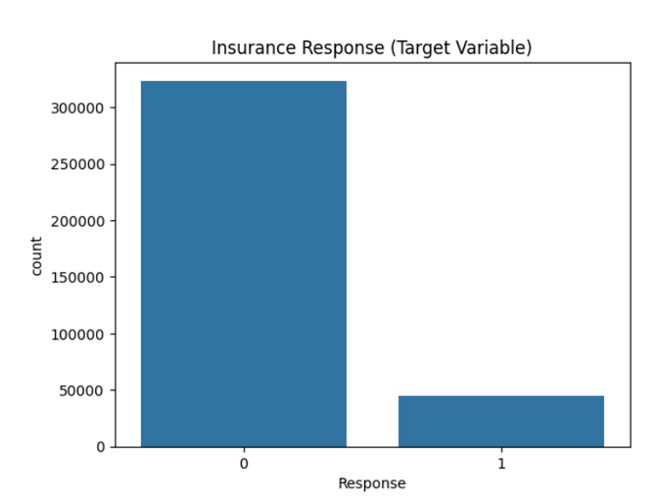
FEATURE INSIGHTS – WHAT DRIVES RESPONSE?
💡 Findings:
🚗 Customers with vehicle damage → more likely to opt in
🧑 Males showed higher claim interest
💵 High premiums didn’t always mean higher responses
🧭 Certain regions and channels outperform others

Slide 8
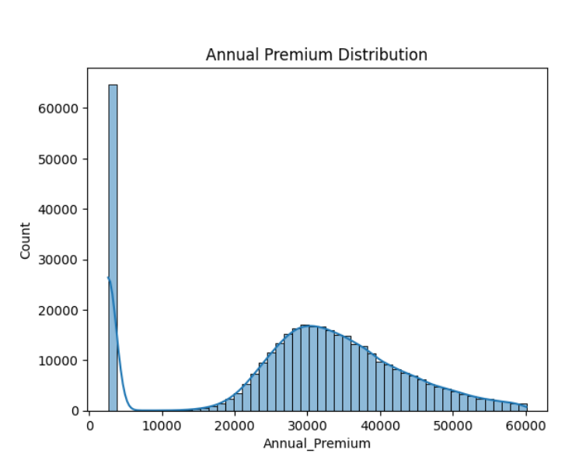
PREMIUM VS RESPONSE
📈 Insight:
Slightly higher premiums saw increased claim interest
📌 Outlier management was crucial to avoid skewed trends
🧠 Useful for pricing strategies and product bundling

Slide 9
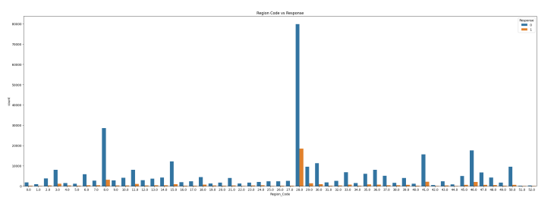
REGION & POLICY CHANNEL TRENDS
🌍 Regional Patterns:
Strong variance in interest across region codes
Targeted marketing can be geo-optimized
🛠️ Sales Channel Performance:
Some channels outperform consistently
Insights can inform agent training and allocation

Slide 10

REAL-WORLD IMPACT
🎯 What This Means for Business:
Reduce acquisition cost by focusing on damage-history customers
Improve underwriting accuracy
Boost conversion through high-performing channels
SCENE 4
FUTURE STEPS
Create your own scene that would trigger a car insurance event.
Search in 'Elements' in the sidebar to add your own graphics.
🔮 Next Up:
Build a classification model (Logistic Regression, XGBoost)
Apply feature engineering to optimize performance
Deploy insights into a dashboard (Tableau/Power BI)

